Slide 1
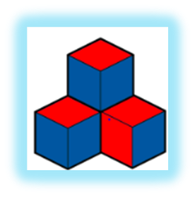
Geometry
Module 1
Notes:
Introductions
Recognize the grade level curriculum writers

Slide 2
Module 1
August 26, 2019
-Introduction -Syllabus -Class Schedule-Changing
-Geometry Talk -Developing Geometric Thinking - Standards for Mathematical Practices
-Levels of Geometric Thought
-Activities associated with Levels -Homework Assignment Due Aug 30, 2019 to Canvas - Reminder Aug 2, 2019 is Labor Day NO Class!

Slide 3
Student Introductions
-Name
-Math makes me feel…
-Grade level (span) of choice
-1 fact about you

Slide 4
Geometry Talk
What do you see?
What do you notice?

Slide 5
What is a Geometry MathTalk?
Why do Math Talks?

Slide 6
8 Mathematical Practice Standards

Slide 7
Standards for Mathematical Practice

Slide 8
Standards for Mathematical Practice Sorting Activity

Slide 9
Activity: 8 Math Practices with Geometry
Materials: Ziploc bag with pink and white cards
Directions: With a partner lay out the 8 Math Practices (….. cards). Then read through the white cards together. Determine which practice each card is illustrating. Cards could be placed in more than one place, but at the end of the activity, there should be one card for each of the 8 Math Practices.

Slide 10
Developing Geometric Thinking
Described by five-level hierarchy, each level describes the thinking and understanding of how geometry is developed.

Slide 11
Levels of Geometric Thought
Read this article to better gain a better understanding of these Levels of the Van Hiele theory.
Analysis of deductive systems
Deductive systems of properties
Relationships between Properties
4. Rigor
3. Deduction
2. Informal Deduction
1. Analysis
0. Visualization
Properties of Shapes
Classification of Shapes
Shapes

Slide 12
Levels of Geometric Thought

Slide 13
Spatial Sense
1
2
Geometric Reasoning
Geometric Content
3
Geometry Goals
For Students
Notes:
(

Slide 14
Characteristics of Van Hiele Levels
Levels are sequential
Levels are not age-dependent
Geometric experience is key
Instruction must match student’s level of thought
Build Math Minds

Slide 15
Assessing Math Understanding
Complete the assessment on your own. Then think about the possible misunderstandings or difficulties some elementary school children might have when completing this assessment.

Slide 16
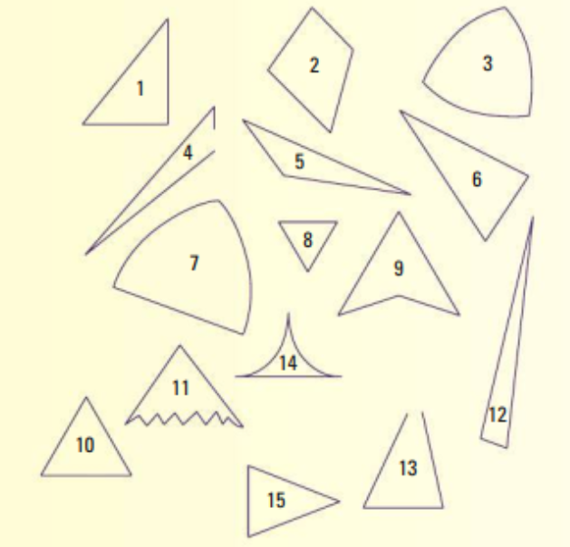
Which of the Shapes below are triangles? Explain why each shape is or is not a triangle.
Watch Student Videos

Slide 17
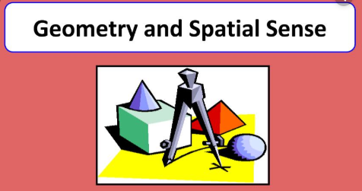
Spatial sense is an intuitive feel for shape and space. It involves the concepts of traditional geometry, including an ability to recognize, visualize, represent, and transform geometric shapes.
Like number sense spatial sense includes the ability to mentally visualize objects and position
Meaningful experiences with shape and spatial relationships, when provided consistently over time can and will develop spatial sense.
Return

Slide 18
Geometric Reasoning-is the use of critical thinking, logical argument and spatial reasoning to solve problems and find new relationships. ... The purpose of geometric reasoning is to determine results from previously established truths and to then apply these results in the solution of problems.
Finding attributes of geometric objects using their intrinsic properties, their relationships with other objects, and the inference rules.
Geometric Reasoning
Return

Slide 19
Shapes and Properties-includes a study of the properties of shapes in two dimensions and three dimensions, as well as a study of the relationships built on properties.
Transformations-study of symmetry, translations, reflections, rotations, and similarity.
Location- refers primarily to coordinate geometry of how an object is located on a plane or in space.
Visualization-recognition of shapes, relationships between shapes and ability to draw and recognize objects from different points of view.
Geometric Content
Return

